Slide 1
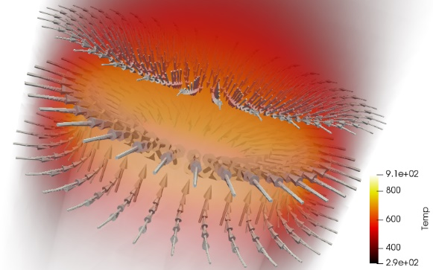
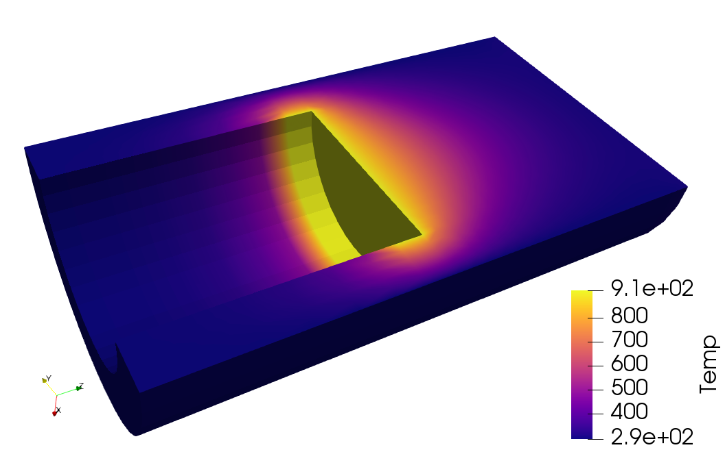

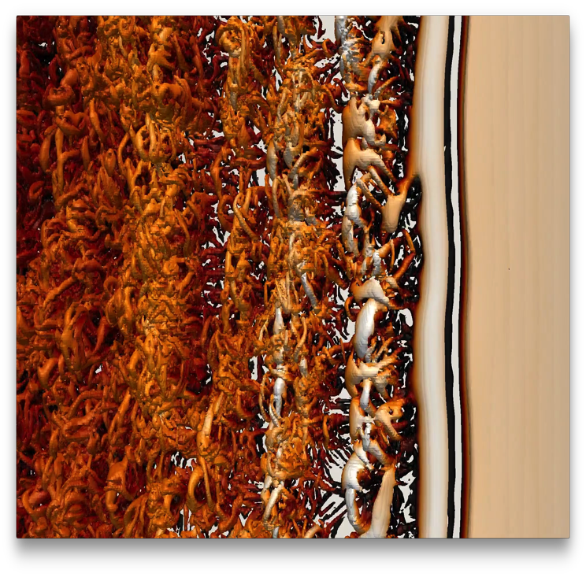
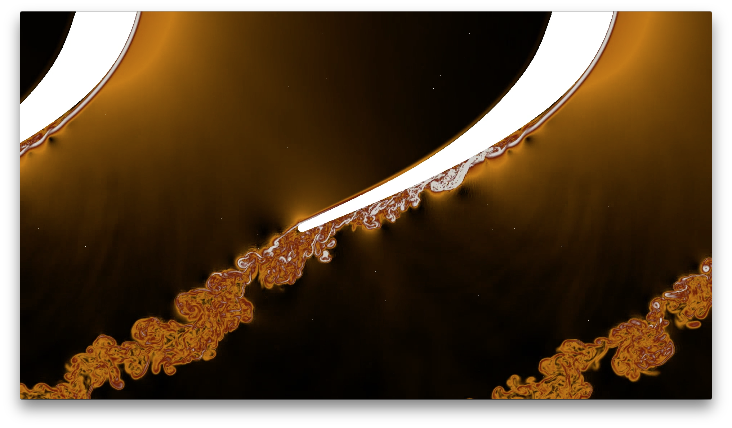
VTK-m Update
DOECGF 2018
April 24, 2018
Kenneth Moreland Sandia National Laboratories

Slide 2


Acknowledgements
This material is based upon work supported by the U.S. Department of Energy, Office of Science, Office of Advanced Scientific Computing Research, under Award Numbers 10-014707, 12-015215, and 14-017566.
This research was supported by the Exascale Computing Project (17-SC-20-SC), a collaborative effort of two U.S. Department of Energy organizations (Office of Science and the National Nuclear Security Administration) responsible for the planning and preparation of a capable exascale ecosystem, including software, applications, hardware, advanced system engineering, and early testbed platforms, in support of the nation’s exascale computing imperative.
Sandia National Laboratories is a multimission laboratory managed and operated by National Technology and Engineering Solutions of Sandia, LLC., a wholly owned subsidiary of Honeywell International, Inc., for the U.S. Department of Energy’s National Nuclear Security Administration under contract DE-NA-0003525.
Thanks to many, many partners in labs, universities, and industry.

Slide 3
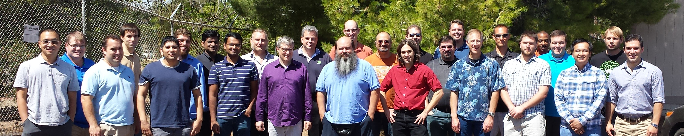
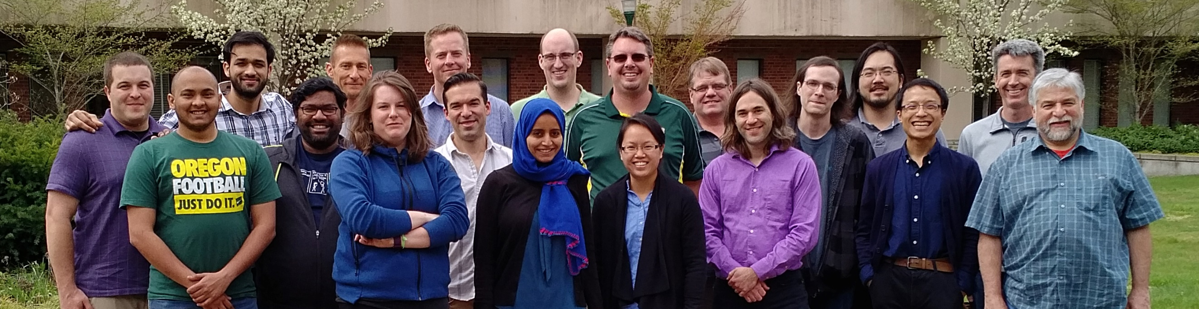
Thanks to All Our Partners!
Code Sprint, September 2015, LLNL
Code Sprint, April 2017, University of Oregon

Slide 4
Why VTK-m?

Slide 5
My new computer's got the clocks, it rocks
But it was obsolete before I opened the box
− “Weird” Al Yankovic, It’s All About the Pentiums, circa 1999
Moore’s Law is dead.
− Gordon Moore, circa 2005
Notes:
Why is this happening now?
In previous years we enjoyed a doubling of clock rate every 18 months
Frustrating to computer buyers but great for HPC
(Technically, it’s Dennard scaling, that power in transistors drops as they shrink, that is dead.)
Now, clock rates have leveled off at 2-4 GHz
Manufactures compensate by adding more cores, more parallelism

Slide 6
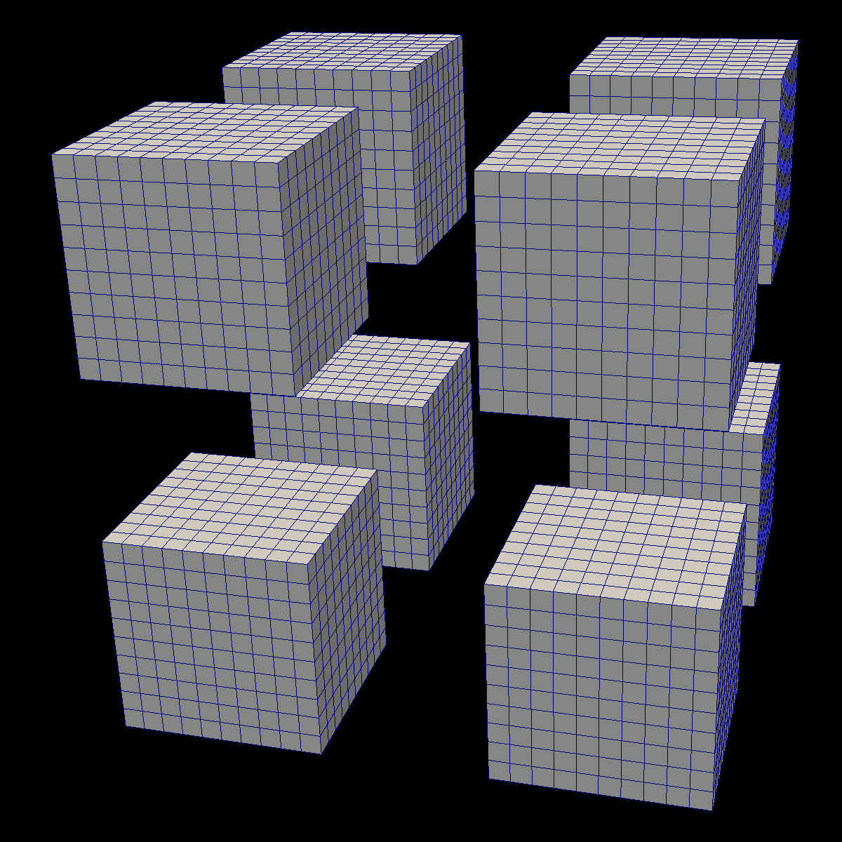
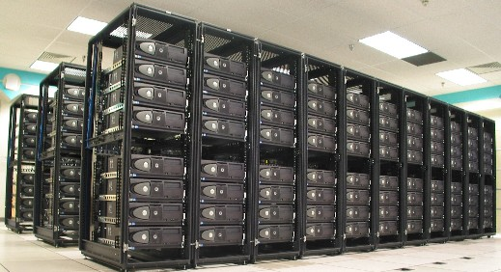


Distributed
Parallelism
ALPINE/
ASCENT

Slide 7
Distributed
Parallelism
ALPINE/
ASCENT
On Node
Parallelism

Slide 8
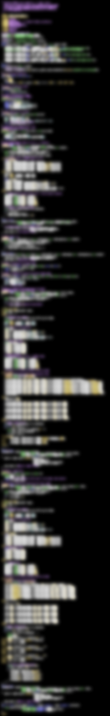
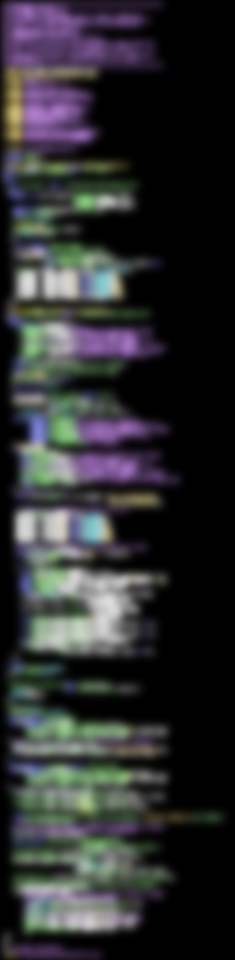
VTK-m
283 Lines
CUDA SDK
561 Lines
Notes:
The source code of Marching Cubes in three different packages. Case tables removed (all essentially the same).
CUDA SDK: marchingCubes_kernel.cu
VTK-m: IsosurfaceUniformGrid.h

Slide 9
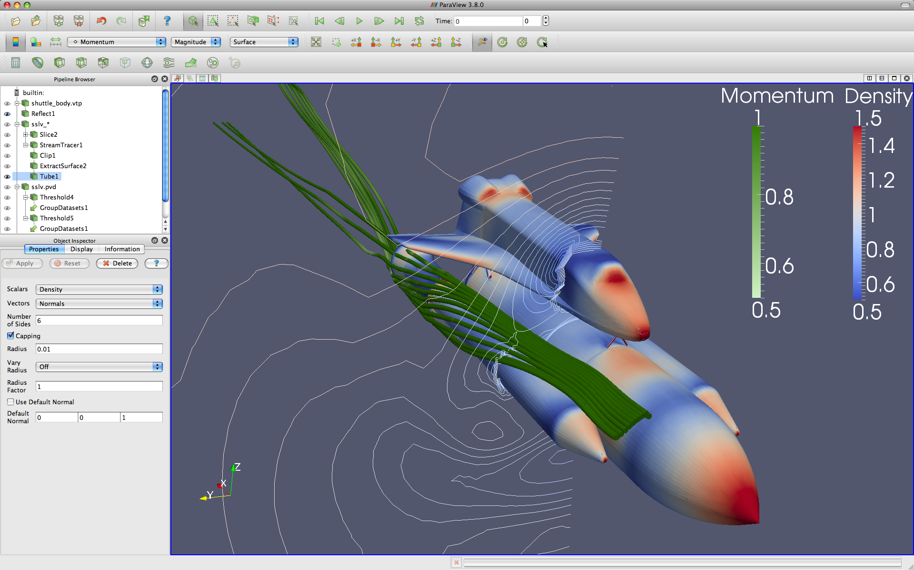



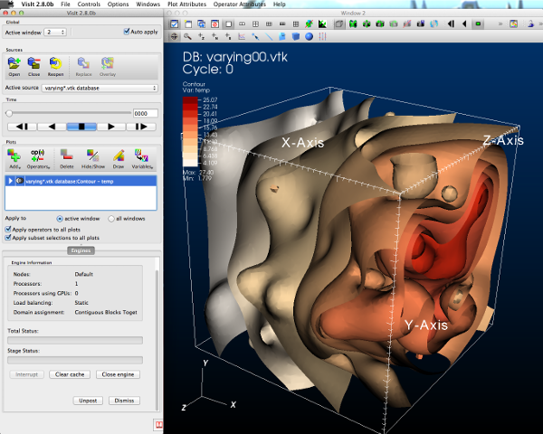



GUI / Parallel Management
Simulations
In Situ Vis Library
(Integration with Sim)
Base Vis Library
(Algorithm Implementation)
Libsim
Multithreaded Algorithms
Processor Portability

Slide 10
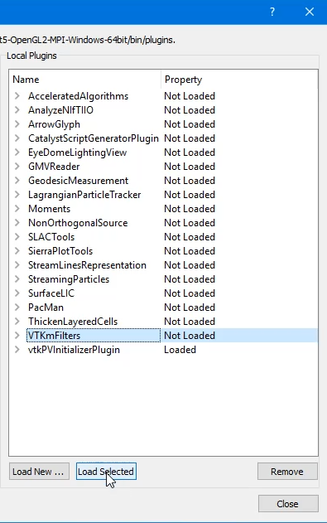
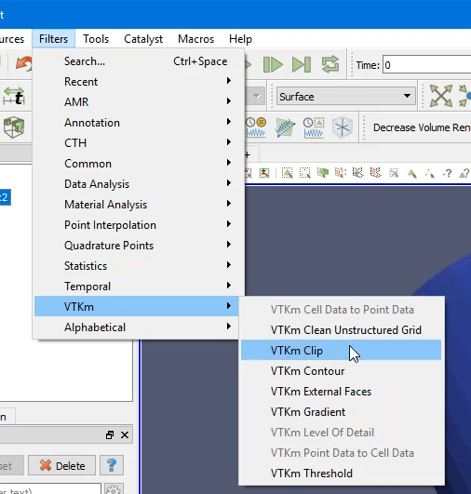
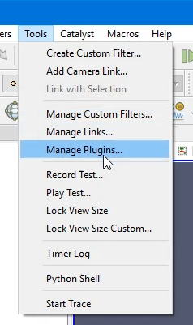
Using VTK-m in ParaView
1. Load VTK-m Plugin
2. Use a VTK-m filter like any other

Slide 11
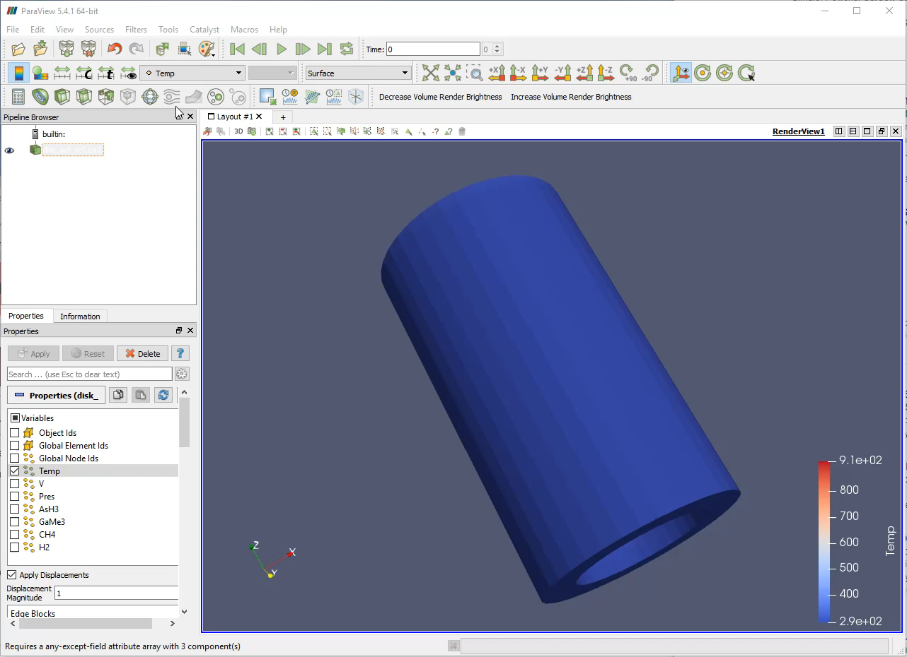

Slide 12
Using VTK-m in VisIt
1. Turn on VTK-m in Preferences
2. Use VTK-m-enabled plots as normal
Slide Credit: David Pugmire

Slide 13
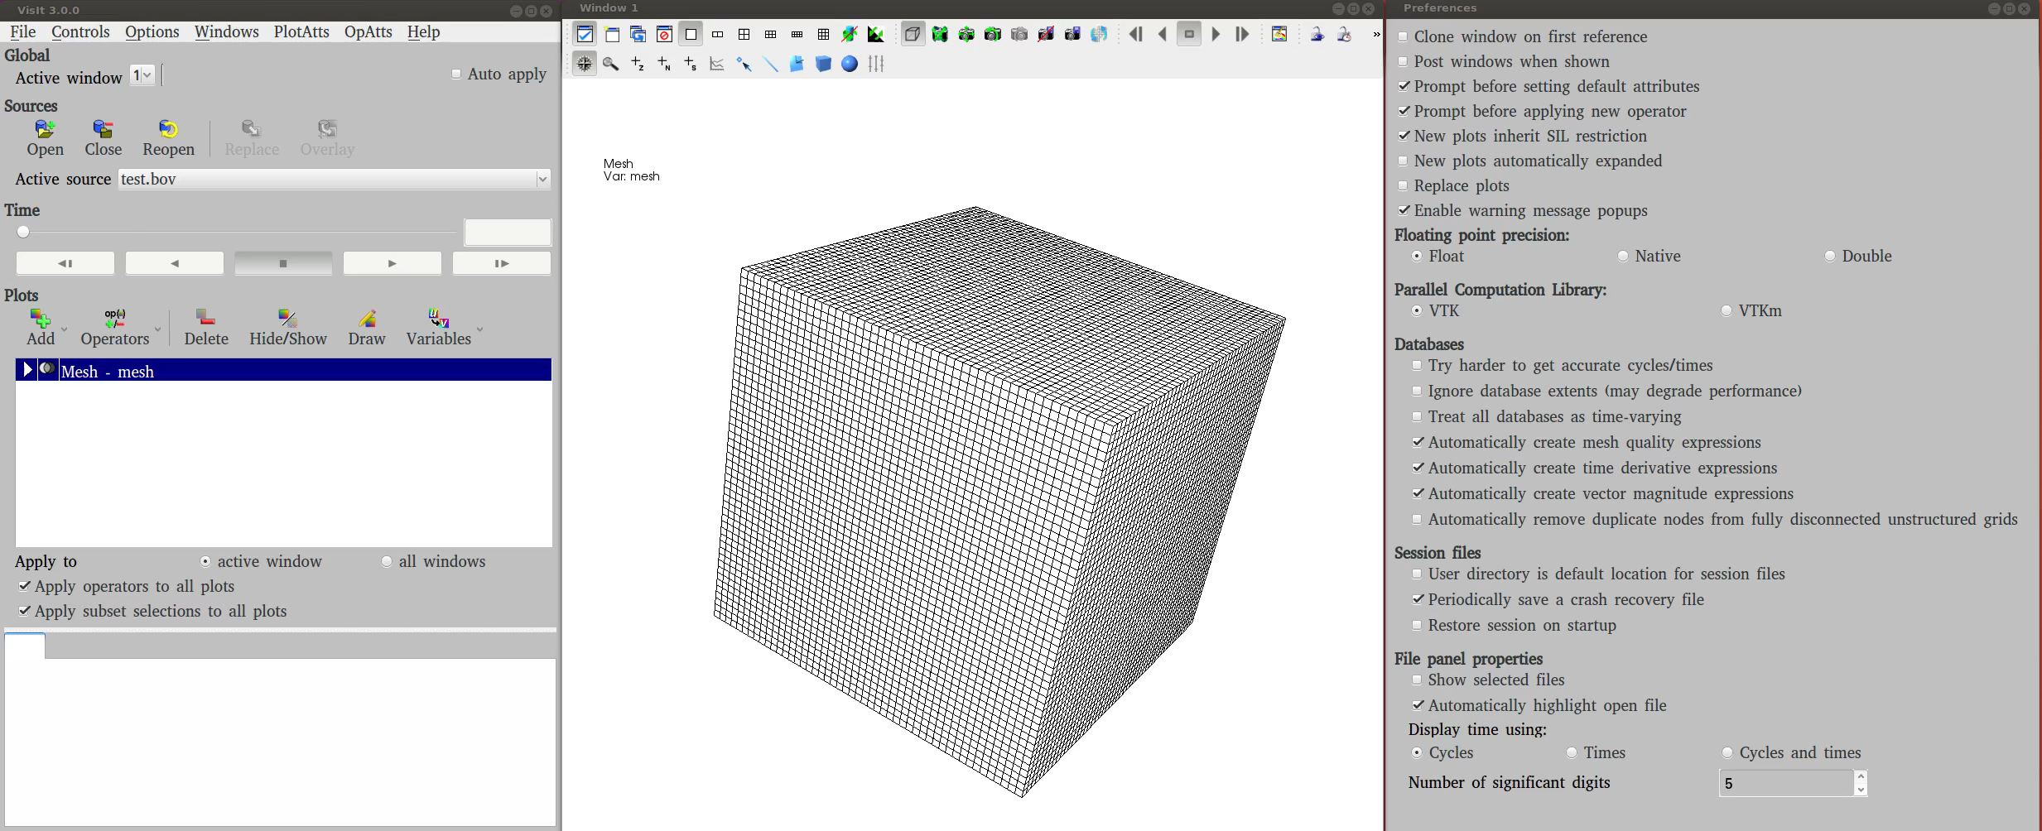
Slide Credit: David Pugmire

Slide 14
What is Going on Now?

Slide 15
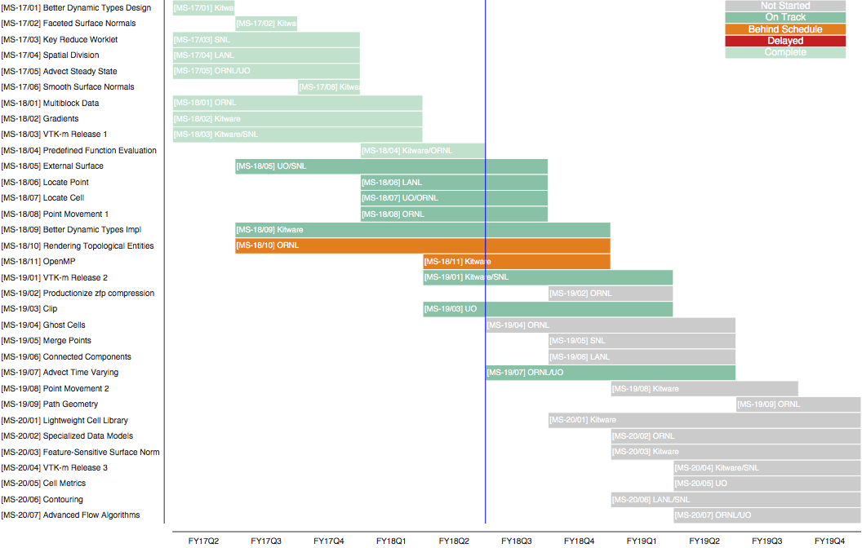
ECP/VTK-m Schedule

Slide 16
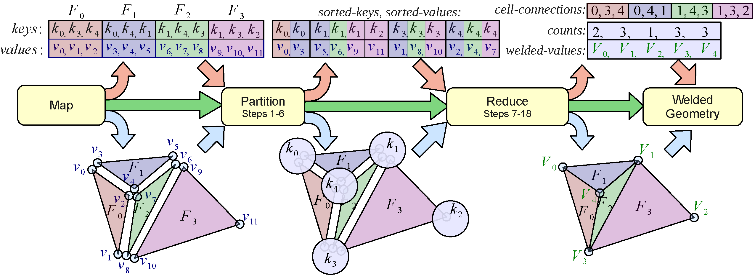
Key Reduce Worklet
"Finely-Threaded History-Based Topology Computation,“ Miller, Moreland, and Ma

Slide 17
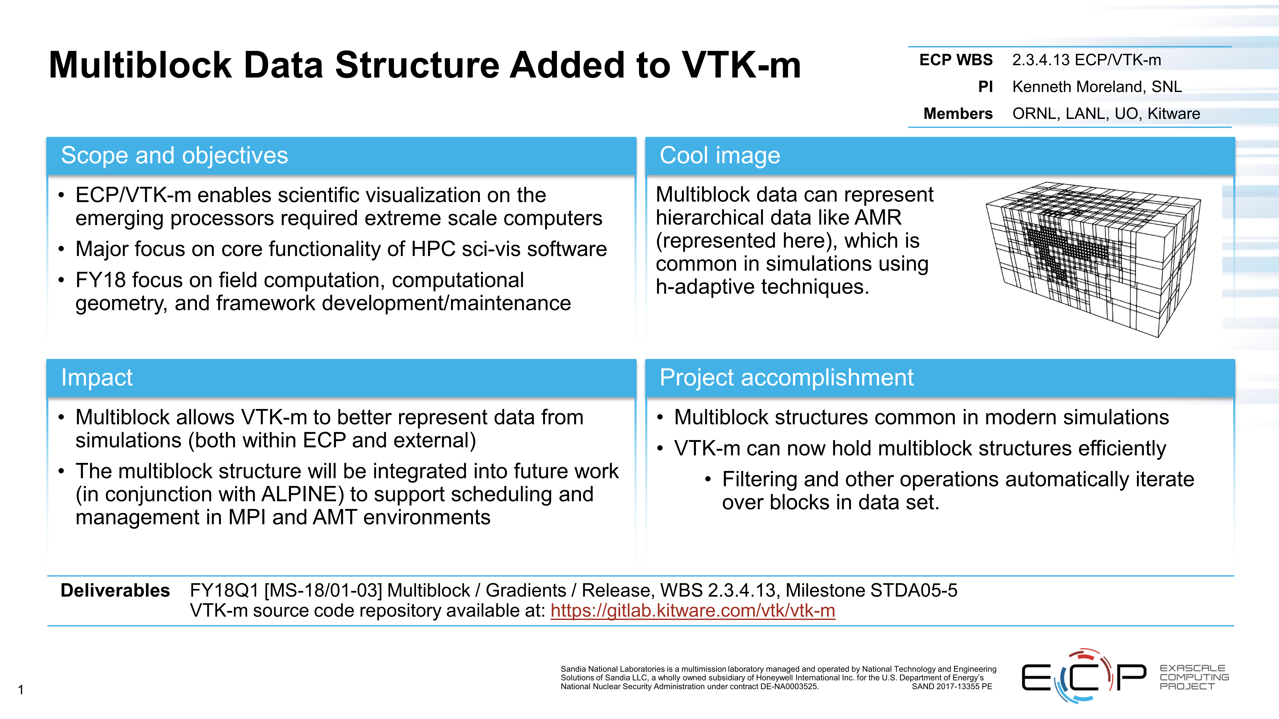

Slide 18
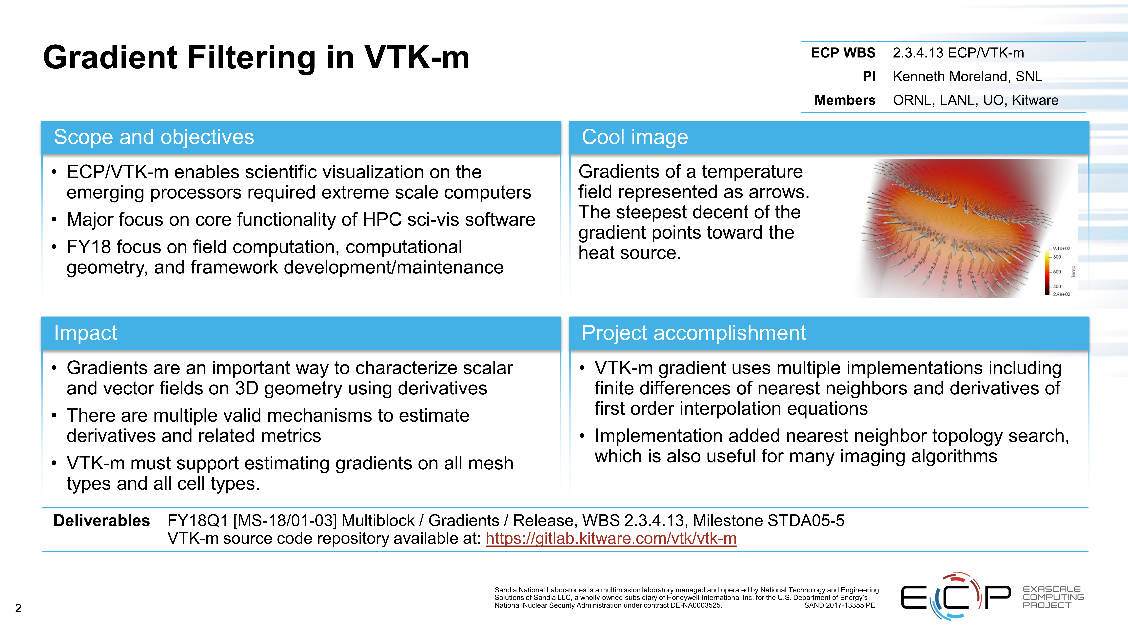

Slide 19
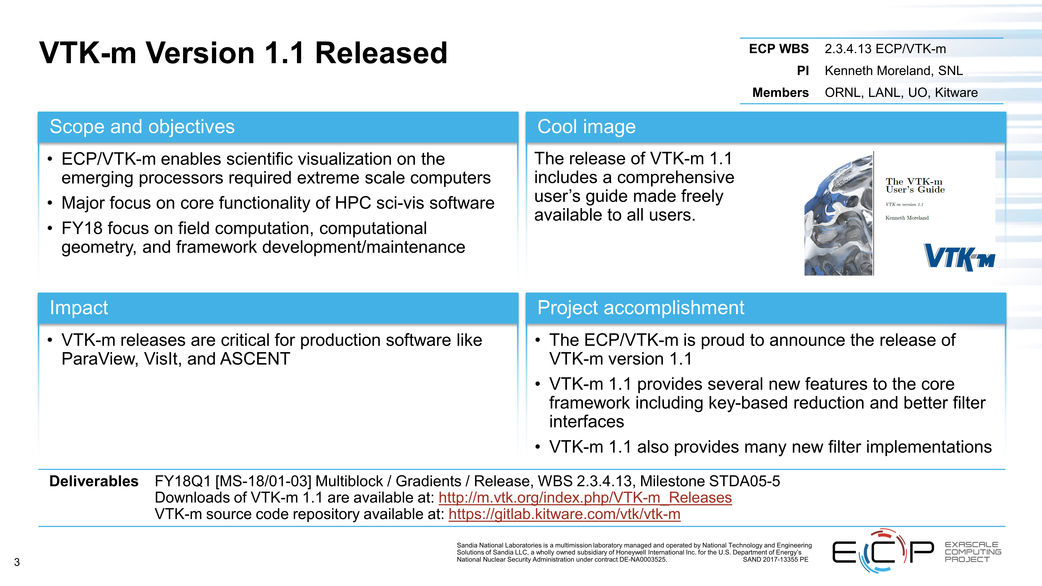

Slide 20
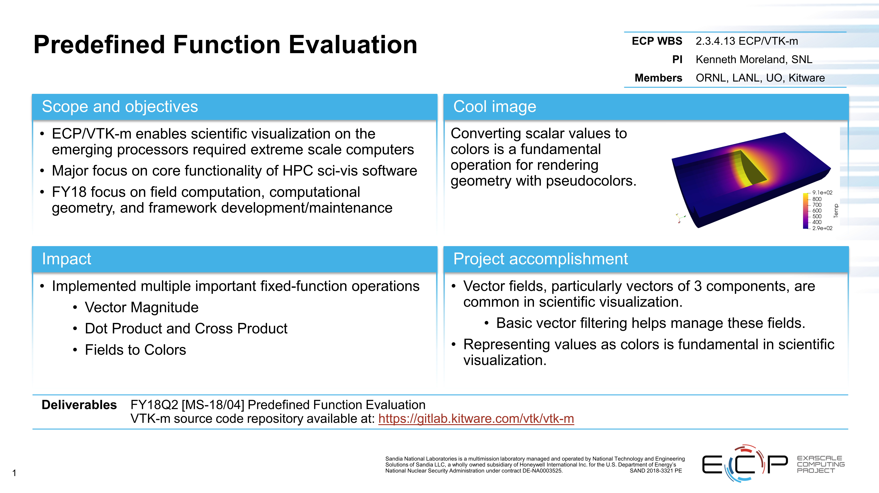

Slide 21
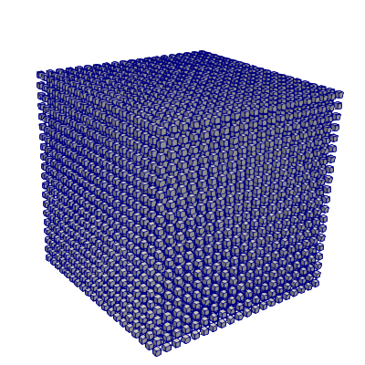
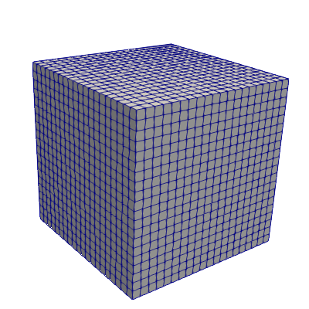
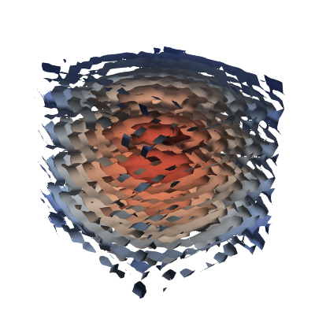
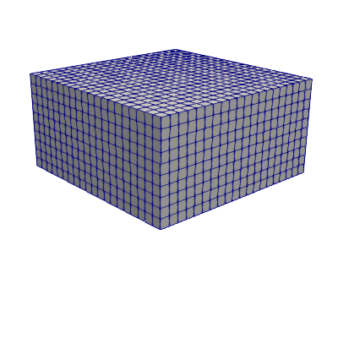
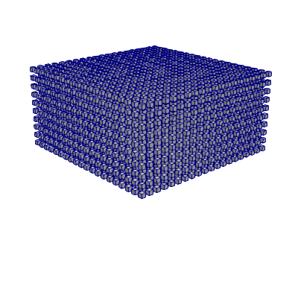
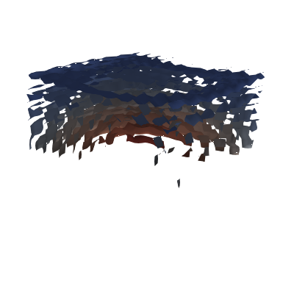
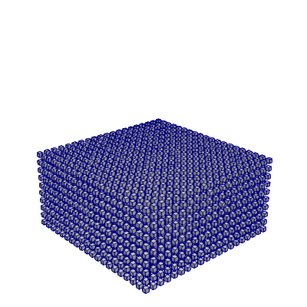
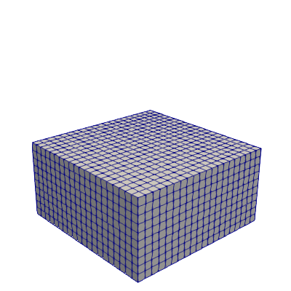
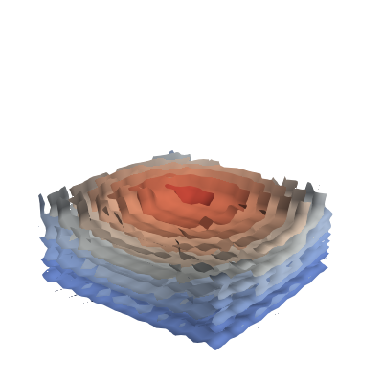


Hybrid parallelism in VTK-m
on-node parallelism
hybrid parallelism
(on-node + MPI/DIY)
New Multiblock data structure
Blocks local and/or distributed
Filters can use DIY or direct MPI
Notes:
Current examples: Histogram, redistribute points
More to come

Slide 22

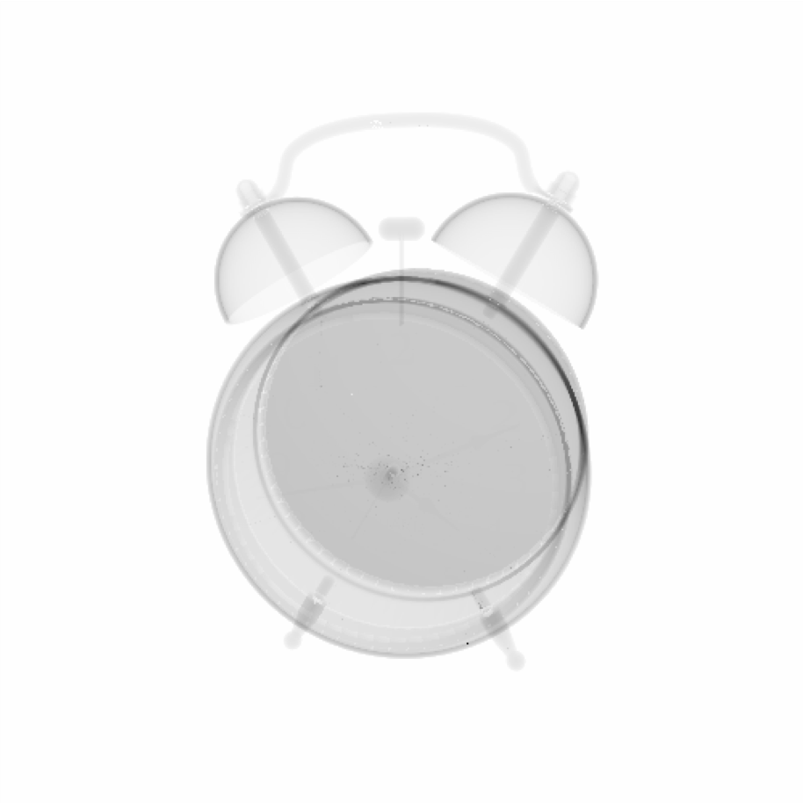
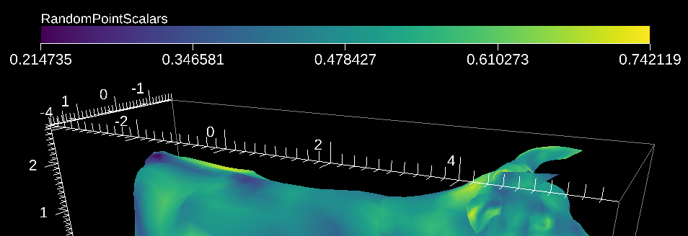
Rendering Improvements
Volume rendering of unstructured grid with different cell types.
Simulated radiography.
Annotations fully supported without OpenGL
Fonts
Color Bars
Bounding Boxes

